Slide 1
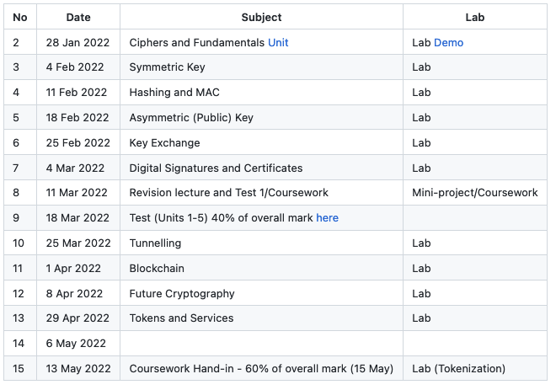
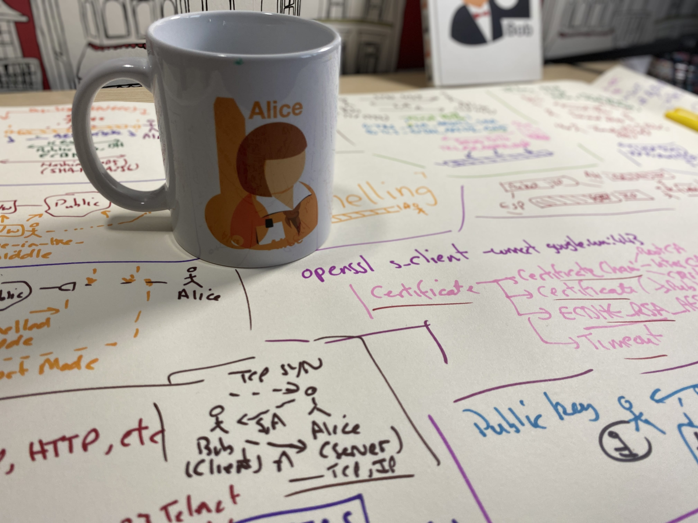
Tokens, Authorization and Docker ERC-20 Tokens
JSON Web Tokens
OAuth 2.0
Fernet Tokens
PAKE
Docker
Prof Bill Buchanan OBE https://asecuritysite.com/tokens/

Slide 2
Authorization and Access

Slide 3
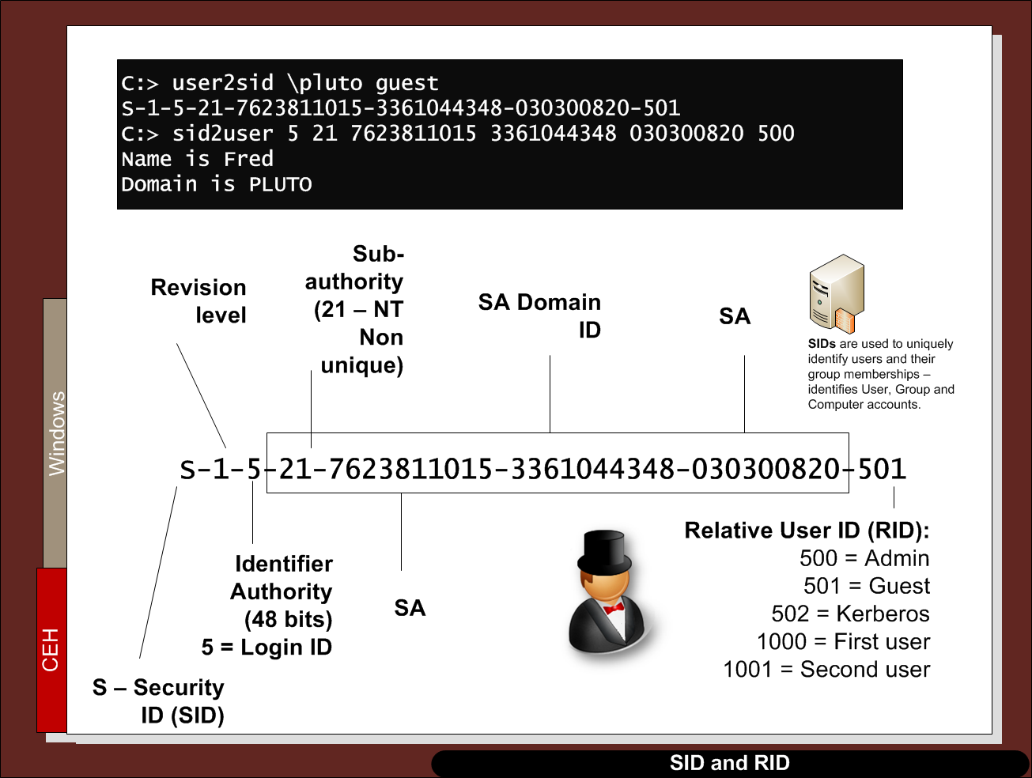

Slide 4
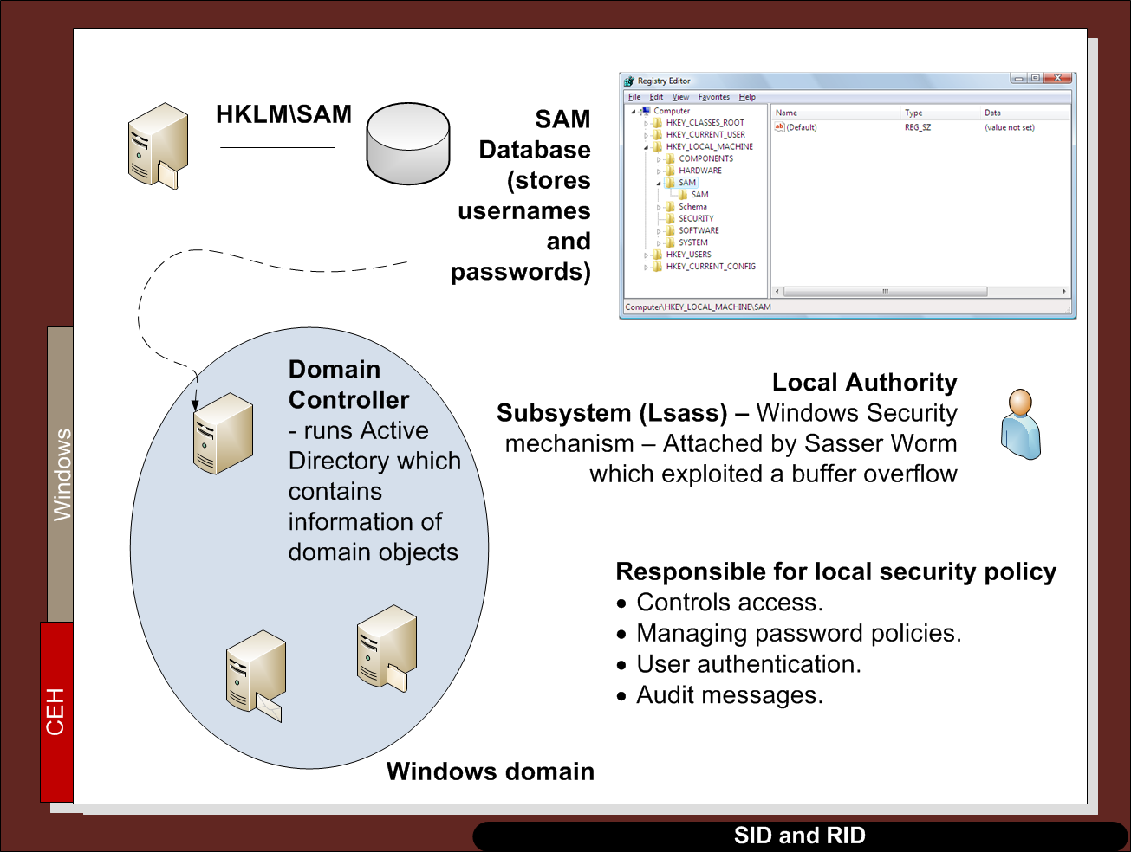

Slide 5
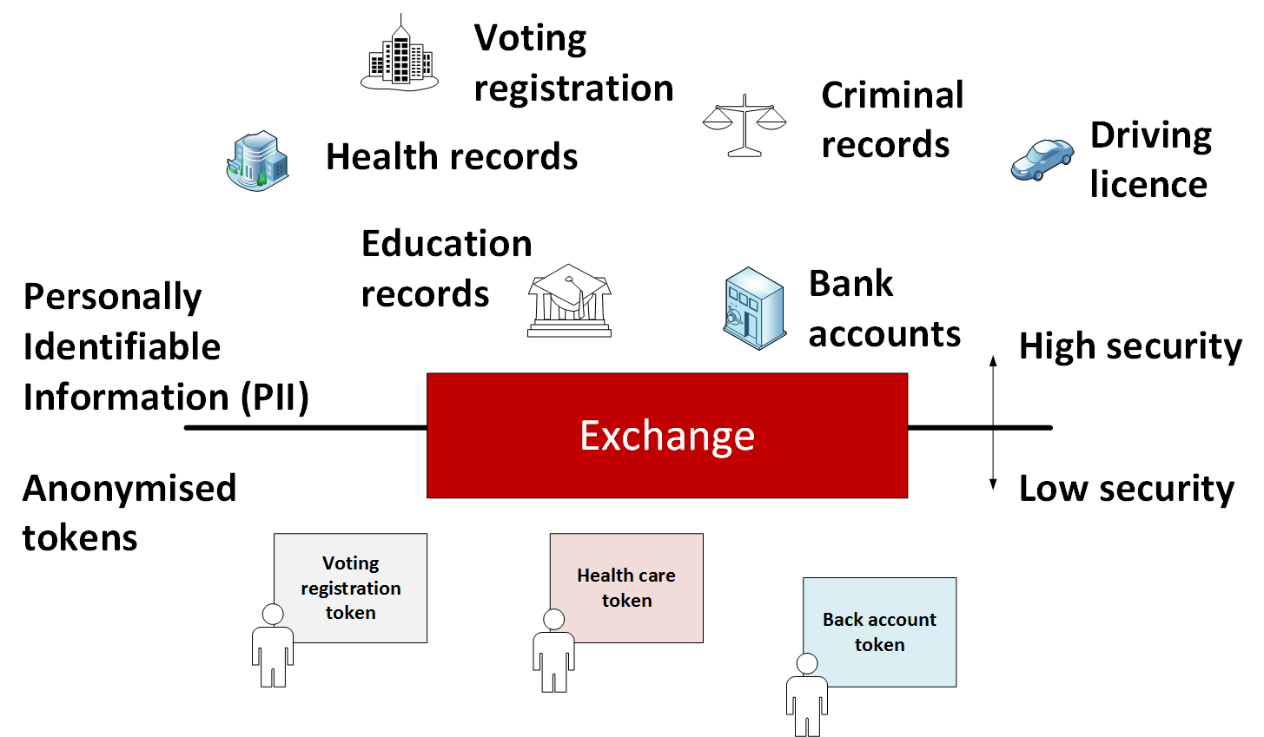
Tokenization with data

Slide 6
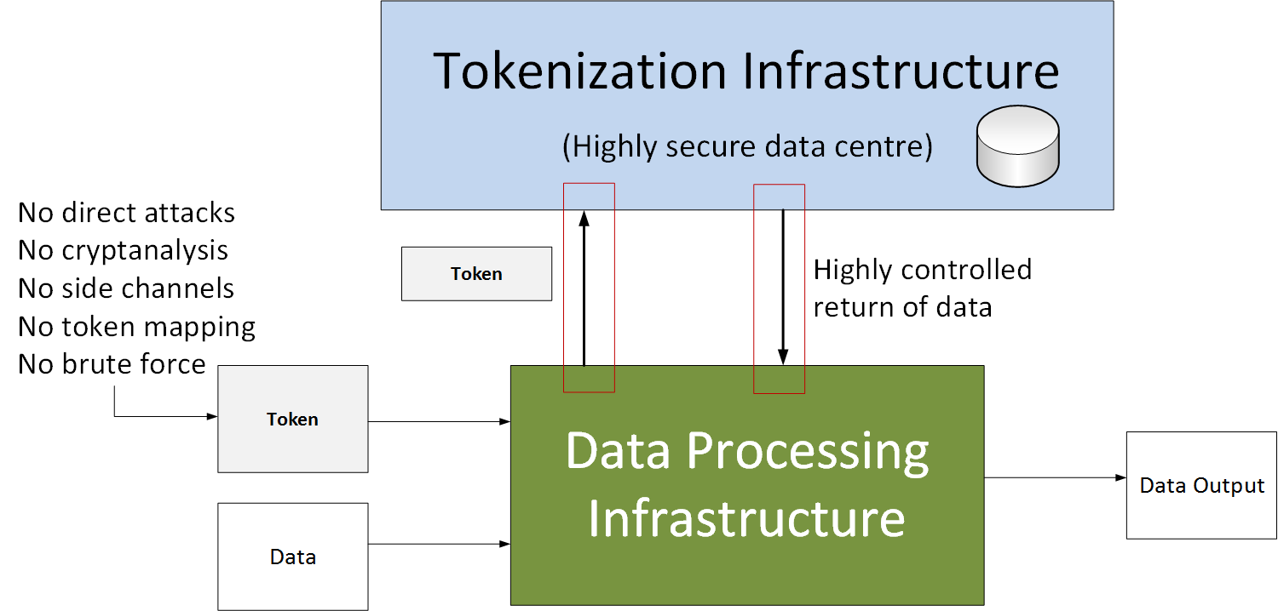
Tokenization with data

Slide 7
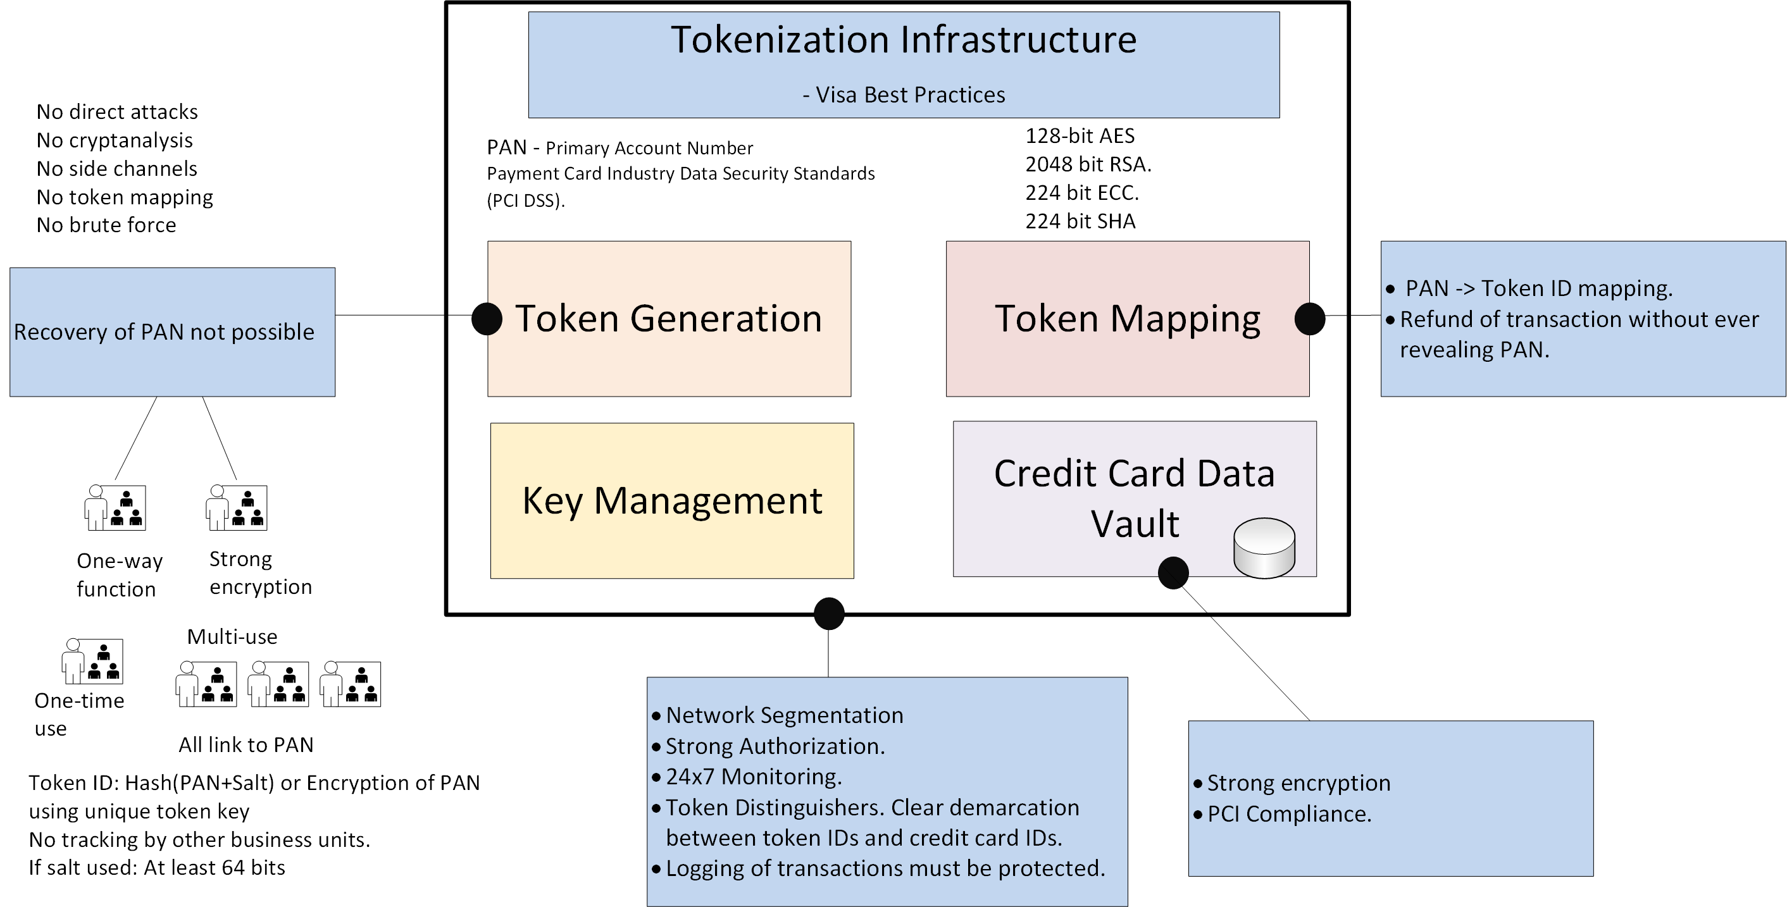
Visa Best Practice for Tokenization

Slide 8
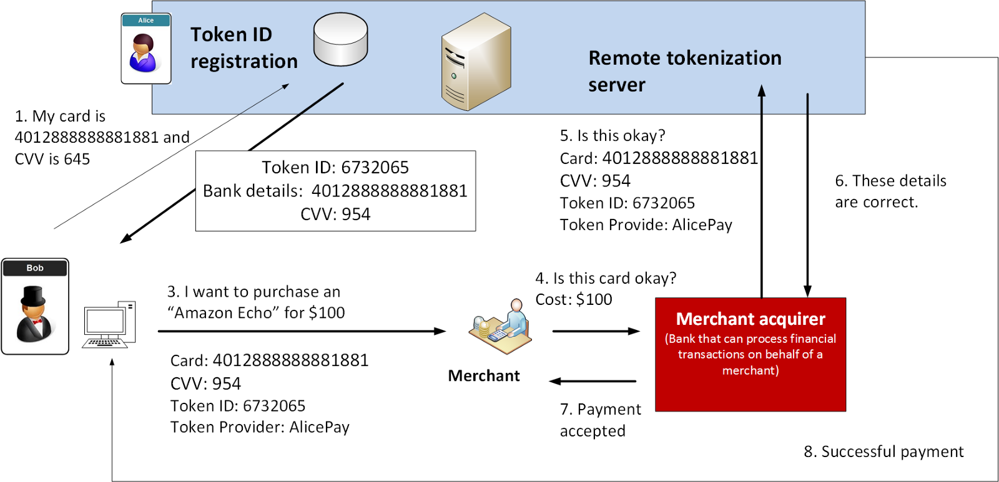
Token Mapping

Slide 9
Tokens, Authorization and Docker ERC-20 and ERC-721 Tokens
Prof Bill Buchanan OBE https://asecuritysite.com/tokens

Slide 10
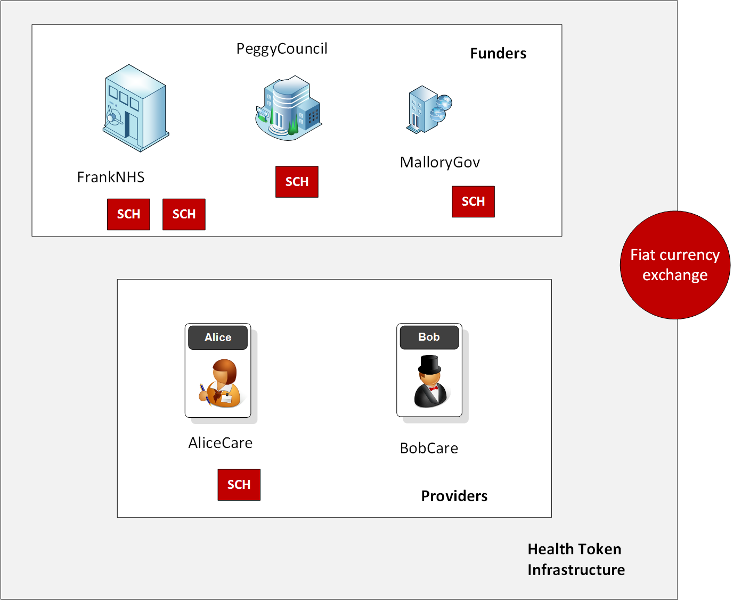
ERC-20 Tokens
Within the Ethereum blockchain we can record transactions and run smart contracts. These things allow us to run DApps (decentralized applications) and which can support the running of the infrastructure in return for some payment (Ether).
A DApp can also create tokens for new currencies, shares in a company or to prove the ownership of an asset.
ERC-20 allow for the sharing, transfer and storage of tokens. View tokens on Ethereum.

Slide 11
ERC-20 Tokens
ERC-20 tokens are supported by the whole of the Ethereum infrastructure and can be easily traded. They support a number of mandatory functions:
totalSupply. This function is the total number of ERC-20 tokens that have been created.
balanceOf. This function identifies the number of tokens that a given address has in its account.
transfer. This function supports the transfer of tokens to a defined user address.
transferFrom. This function supports a user to transfer tokens to another user.
approve. This function checks that a transaction is valid, based on the supply of token.
allowance. This function checks if a user has enough funds in their account for a transaction.
Optional:
Token Name. This is the name that the token will be defined as.
Symbol. This is the symbol that the token will use.
Decimal. This is the number of decimal places to be used for any transactions.

Slide 12

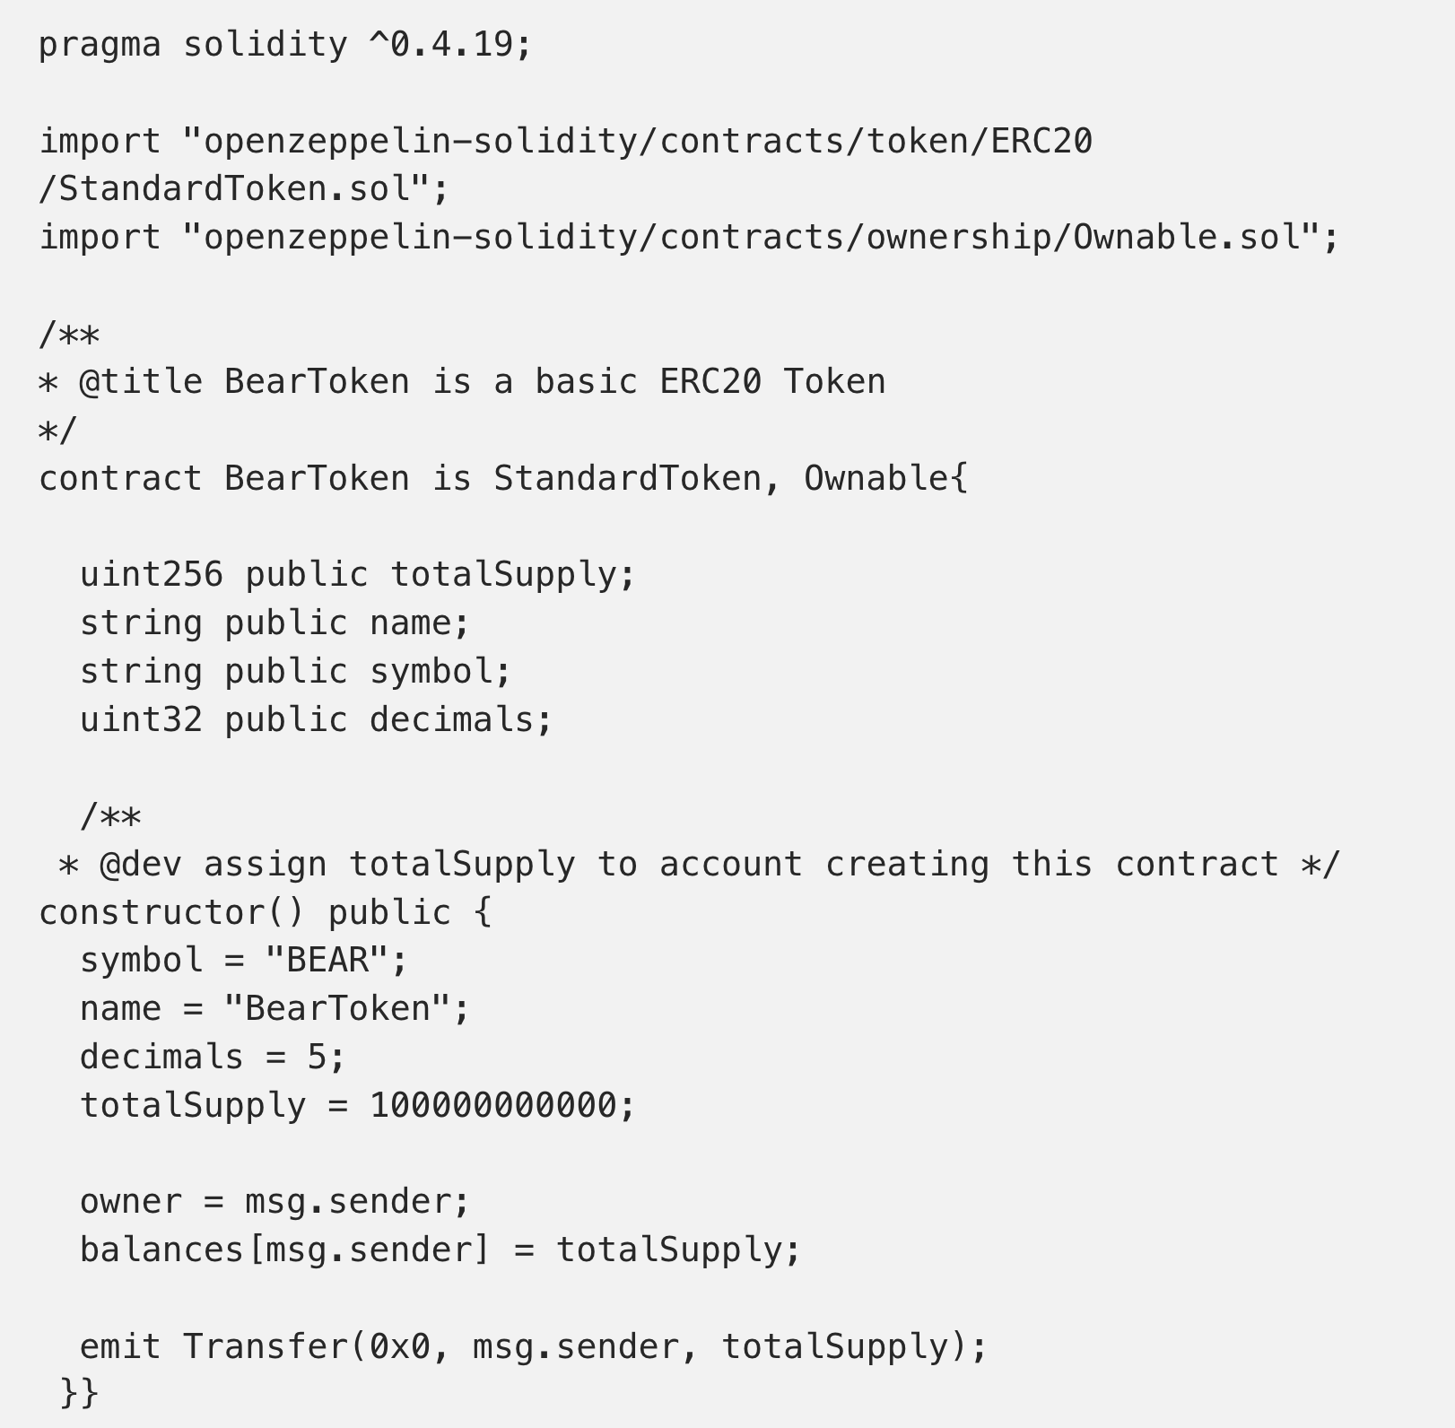
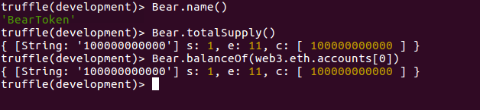
ERC-20 Tokens
ERC-20 tokens are supported by the whole of the Ethereum infrastructure and can be easily traded. They support a number of mandatory functions:
totalSupply. This function is the total number of ERC-20 tokens that have been created.
balanceOf. This function identifies the number of tokens that a given address has in its account.
transfer. This function supports the transfer of tokens to a defined user address.
transferFrom. This function supports a user to transfer tokens to another user.
approve. This function checks that a transaction is valid, based on the supply of token.
allowance. This function checks if a user has enough funds in their account for a transaction.
Details:
- Extends standard contract.
100,000,000,000 tokens.
Name: BearToken
Ref: Build a smart contract that transfers ERC20 token from your wallet to other ERC20 compliant wallet- Part 1, Coinmonks, Medium.com

Slide 13
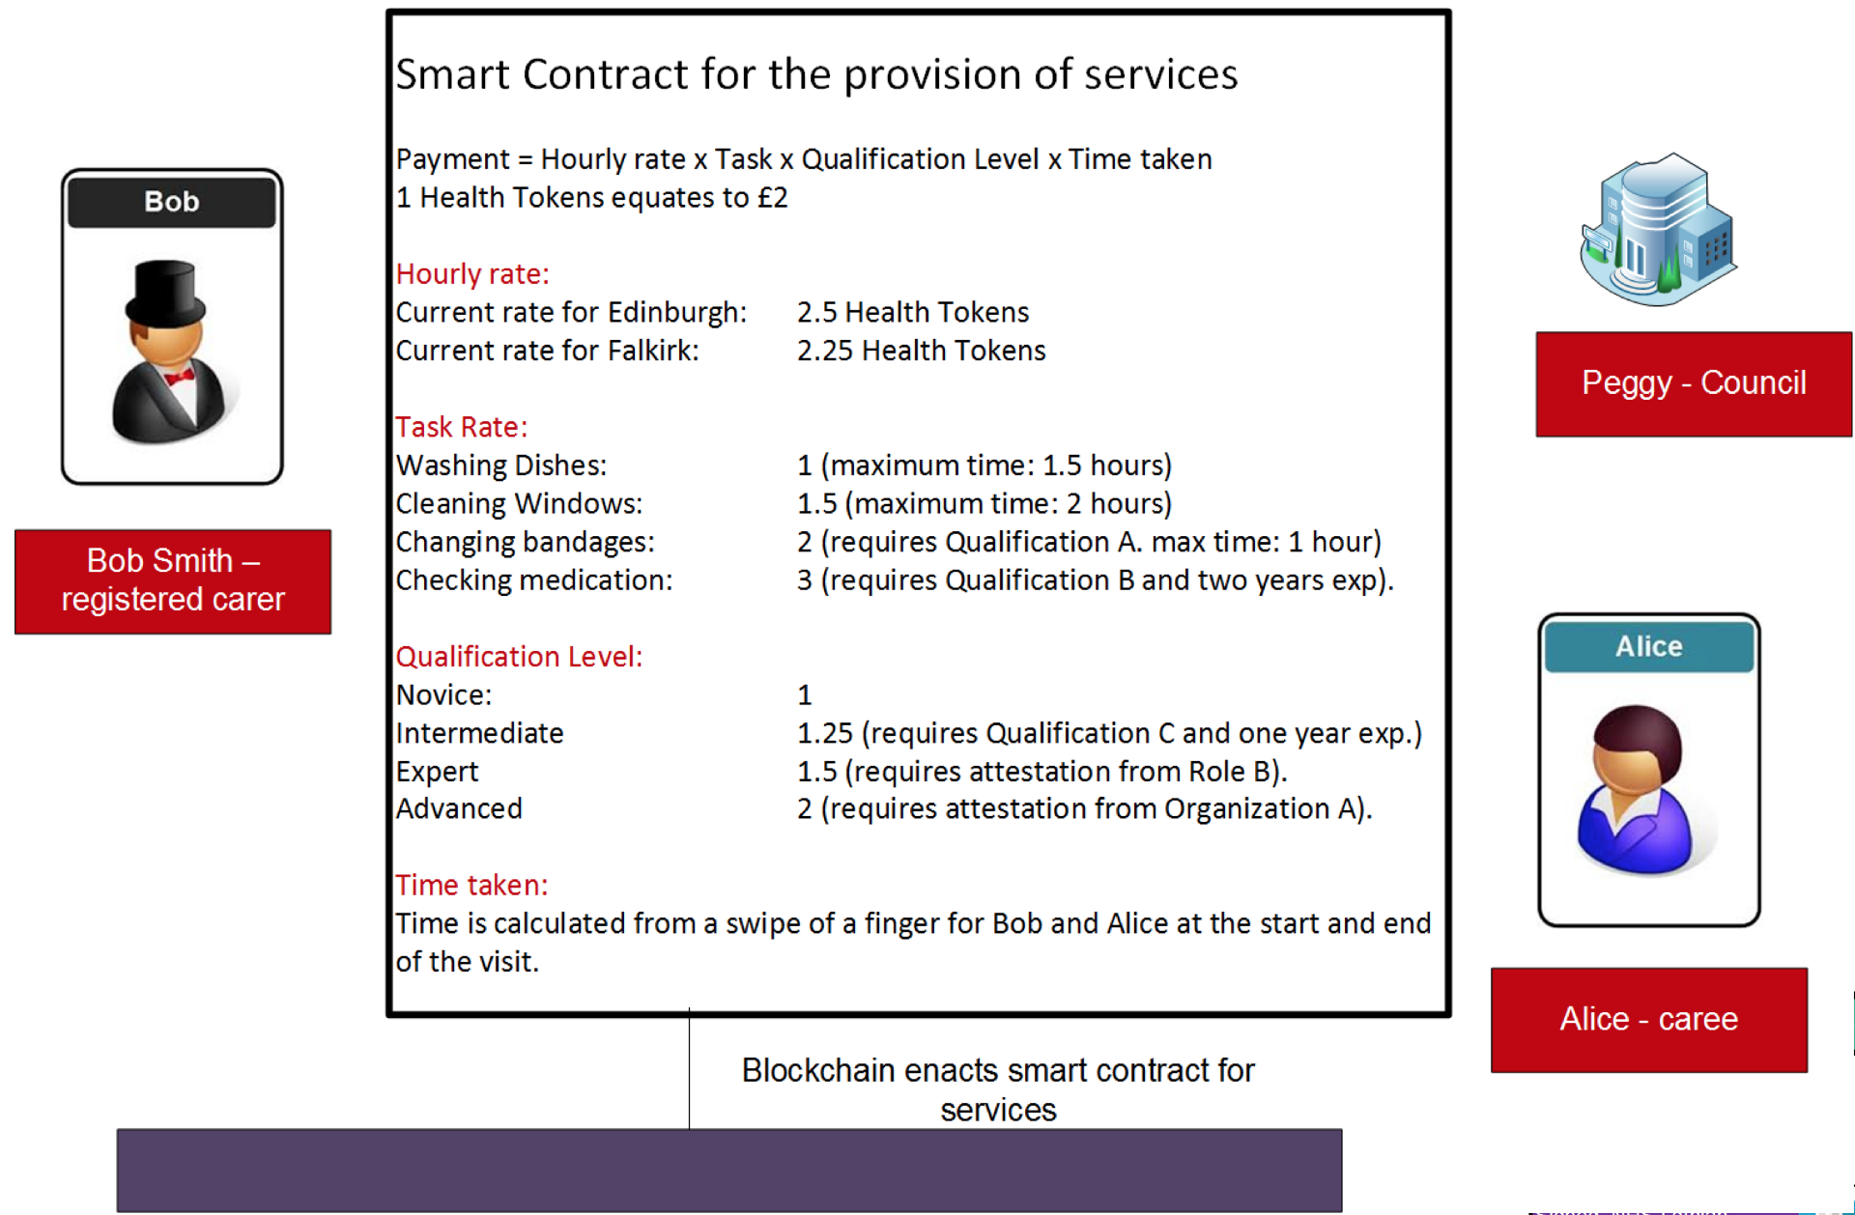
ERC-20 Tokens
Let’s say the budget for the year is to allocate 500 SCH tokens to NHS, 300 to Council and 200 to Government. We would then run the transfer function, and perform these allocations to the Ethereum addresses defined by them. When we conduct the balanceOf function we should see:
NHS: 500 SCH Council: 300 SCH Government: 200 SCH BobCare: 0 SCH
In this case BobCare now agrees a contract with PeggyCouncil to change bandages for Alice — who lives in Edinburgh — and at a rate of 2.5 SCH per hour. The staff at BobCare are at a novice level, so the payment will be 2.5 SCH for one hour’s work. Now once BobCare proves that they have changed Alice’s bandages, PeggCouncil then uses the transferFrom function to move the funds to BobCare.
When we conduct the balanceOf function we should see:
NHS: 500 SCH Council: 297.5 SCH Government: 200 SCH BobCare: 2.5 SCH

Slide 14
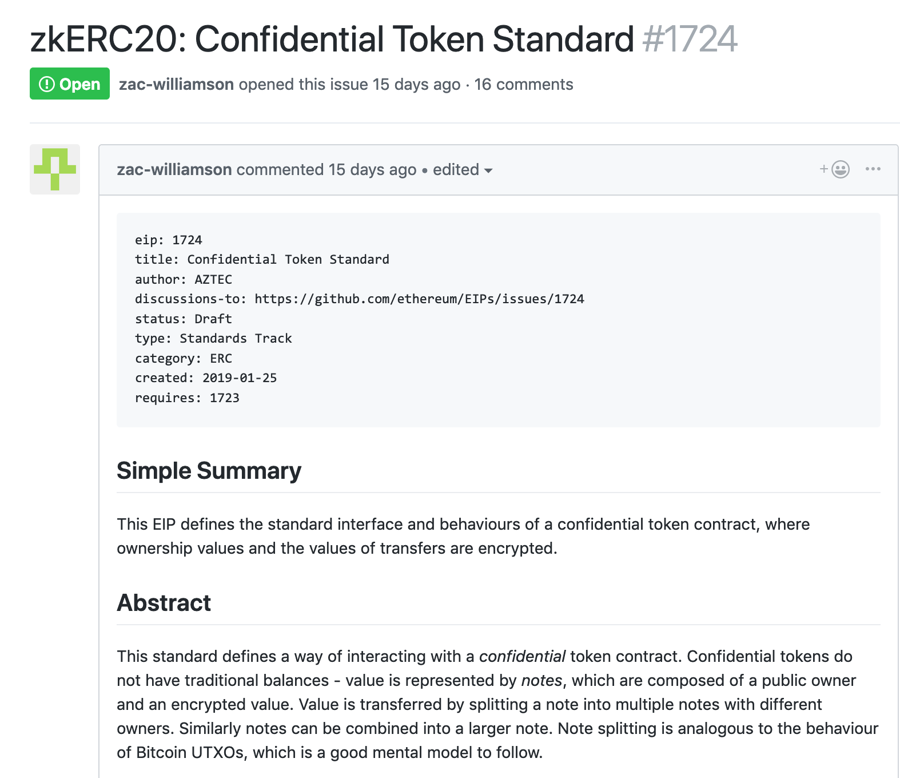
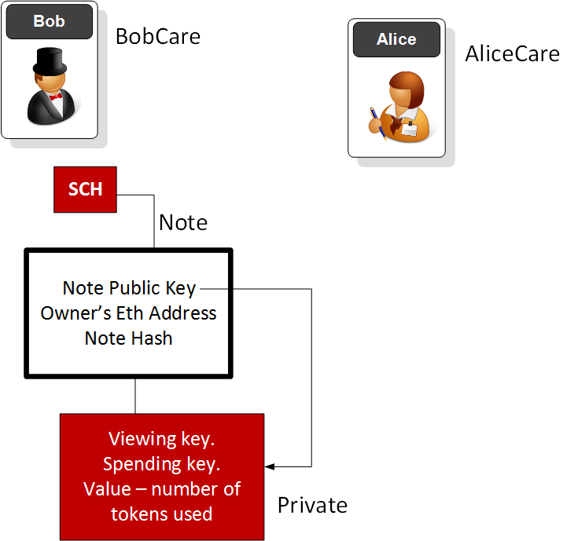
ECR-20 Tokens
Let’s say the budget for the year is to allocate 500 SCH tokens to NHS, 300 to Council and 200 to Government. We would then run the transfer function, and perform these allocations to the Ethereum addresses defined by them. When we conduct the balanceOf function we should see:
NHS: 500 SCH Council: 300 SCH Government: 200 SCH BobCare: 0 SCH
In this case BobCare now agrees a contract with PeggyCouncil to change bandages for Alice — who lives in Edinburgh — and at a rate of 2.5 SCH per hour. The staff at BobCare are at a novice level, so the payment will be 2.5 SCH for one hour’s work. Now once BobCare proves that they have changed Alice’s bandages, PeggCouncil then uses the transferFrom function to move the funds to BobCare.
When we conduct the balanceOf function we should see:
NHS: 500 SCH Council: 297.5 SCH Government: 200 SCH BobCare: 2.5 SCH

Slide 15
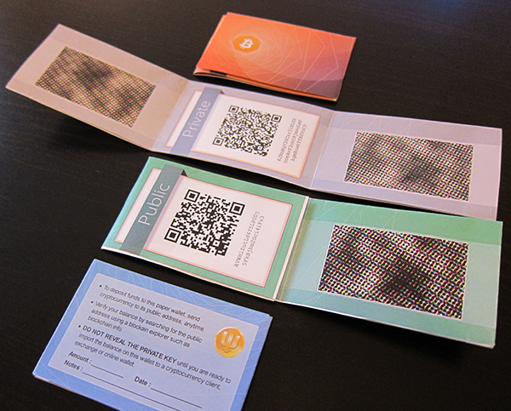
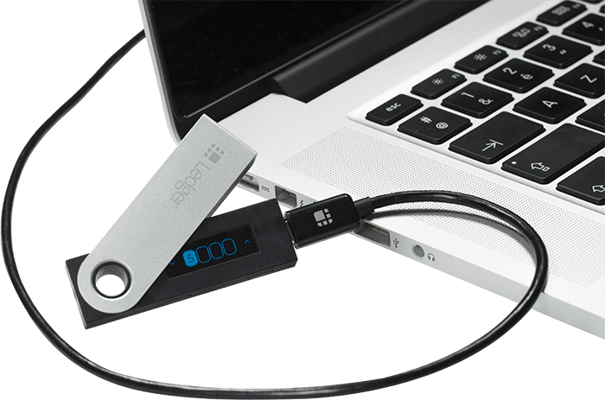
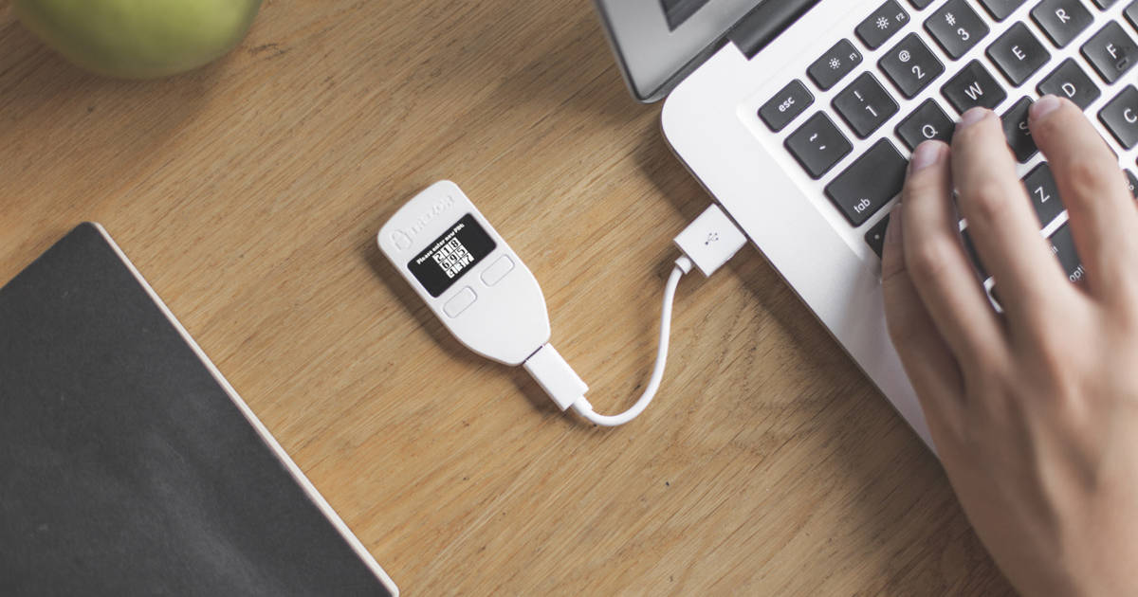
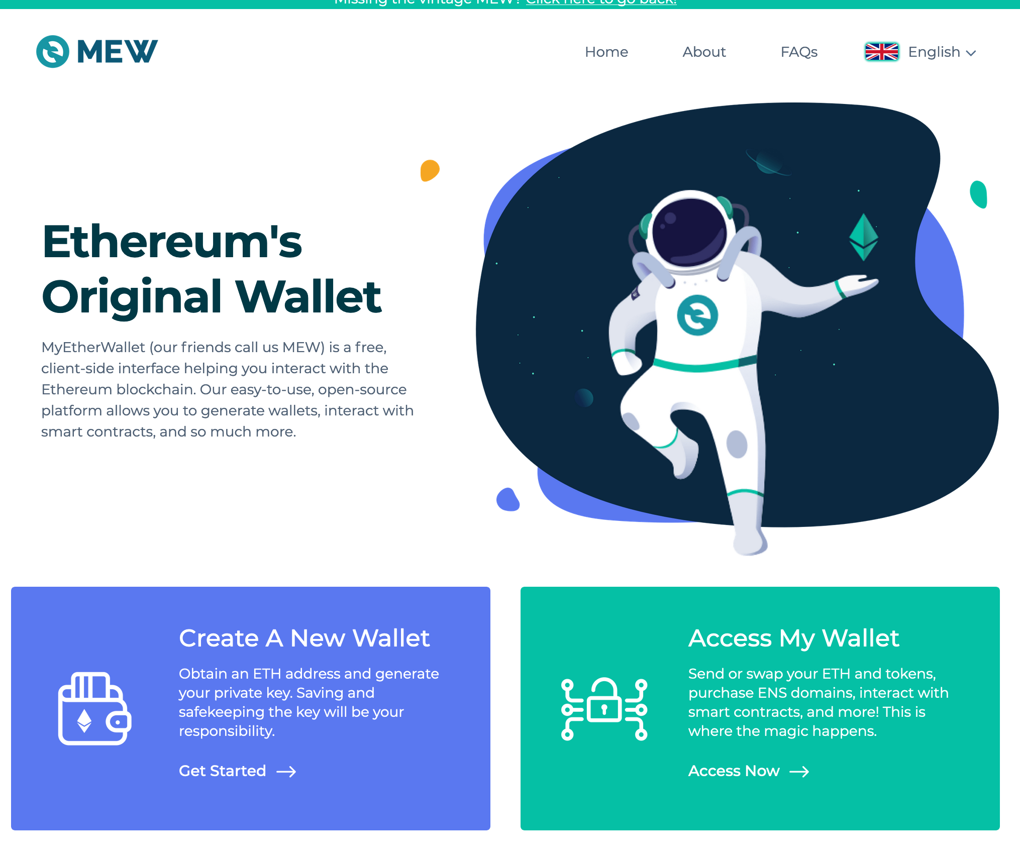
Saving ERC-20 Tokens
Trezor (12-digit code)
Ledger Nano S (Supports 24 cryptocurrencies)
MyWallet (Never saves data on server!) … integrate with Ledger Nano

Slide 16
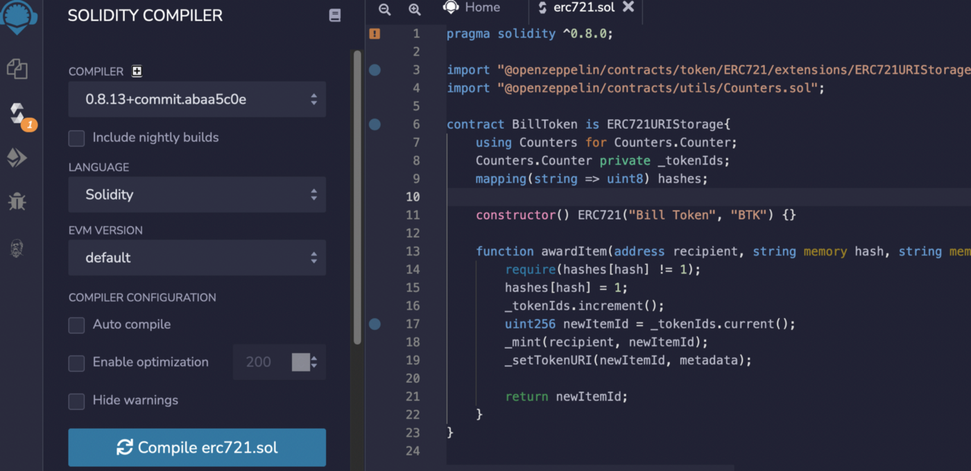
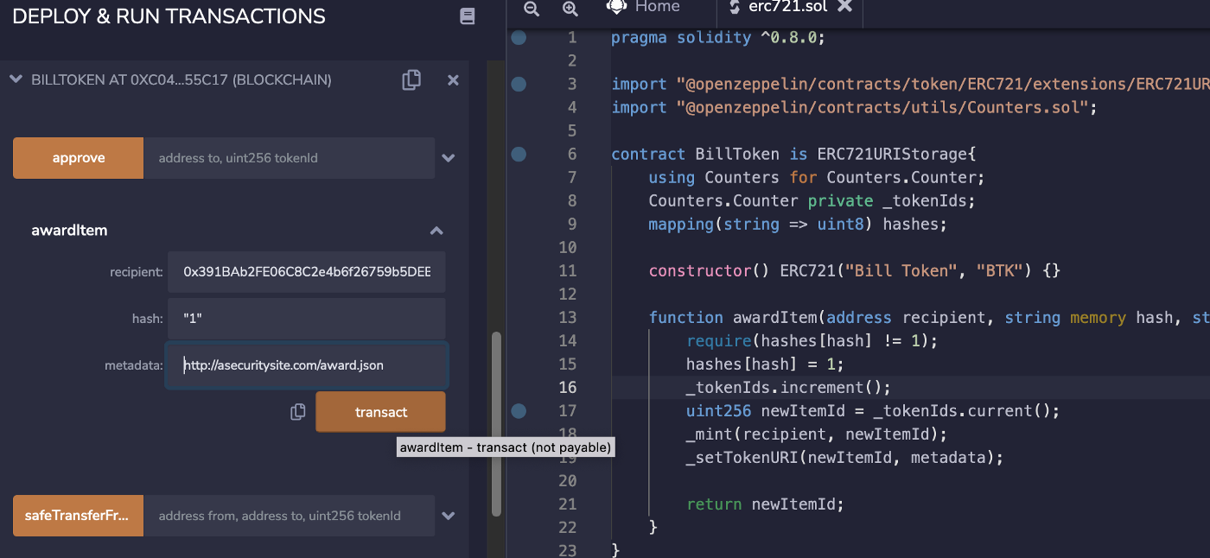
ERC-721 NFTs
https://asecuritysite.com/ethereum/ethereum09

Slide 17
Tokens, Authorization and Docker JSON Web Tokens Prof Bill Buchanan OBE https://asecuritysite.com/tokens/

Slide 18
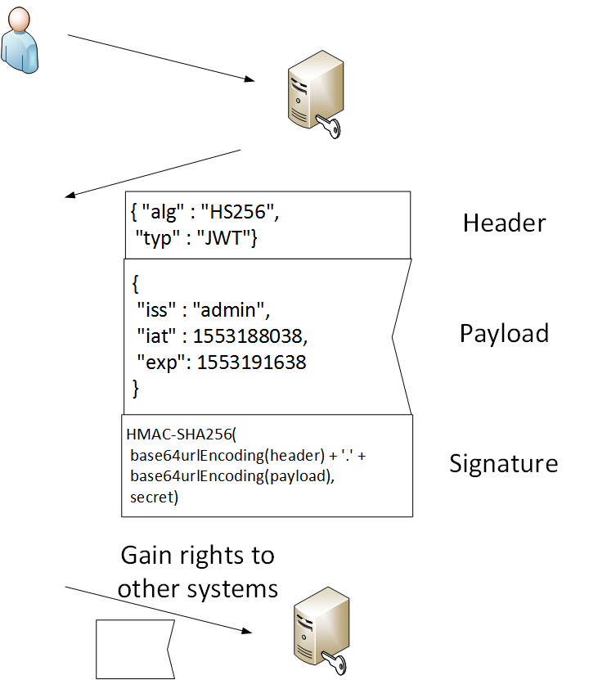
JSON Web Token
alg: HS-256
iss: Used to.
iat: Issued at.
exp: Expires at.
Signing: HS256,
HS364, HS512 and
RS256

Slide 19
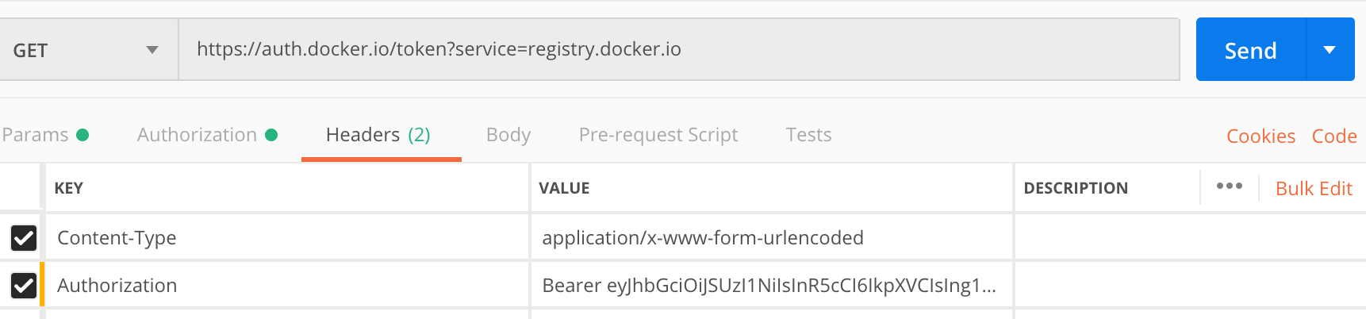
JSON Web Token
eyJ0eXAiOiJKV1QiLCJhbGciOiJIUzI1NiJ9.InsgZm9vOiAnYmFyJ30i.YysrHrgIR351UIruepwNCpwwOfH0feLlibPgASG-ljw
Header:
{
"typ": "JWT",
"alg": "HS256"
}
Payload:
"{ foo: 'bar'}"
Signature:
HMACSHA256(
base64UrlEncode(header) + "." +
base64UrlEncode(payload),
your-256-bit-secret
) secret base64 encoded

Slide 20

Tokens, Authorization and Docker OAuth 2.0 Prof Bill Buchanan OBE http://asecuritysite.com/encryption
http://asecuritysite.com/unit06

Slide 21
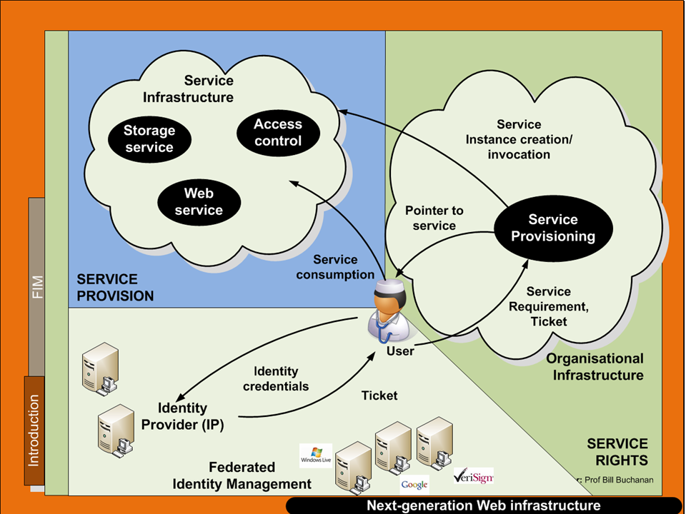
Federated ID

Slide 22
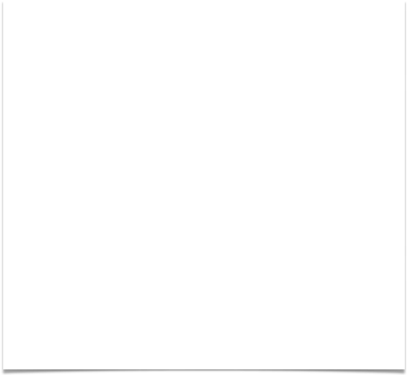
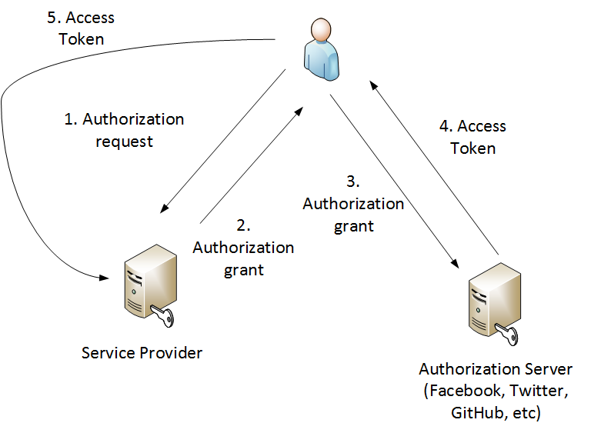
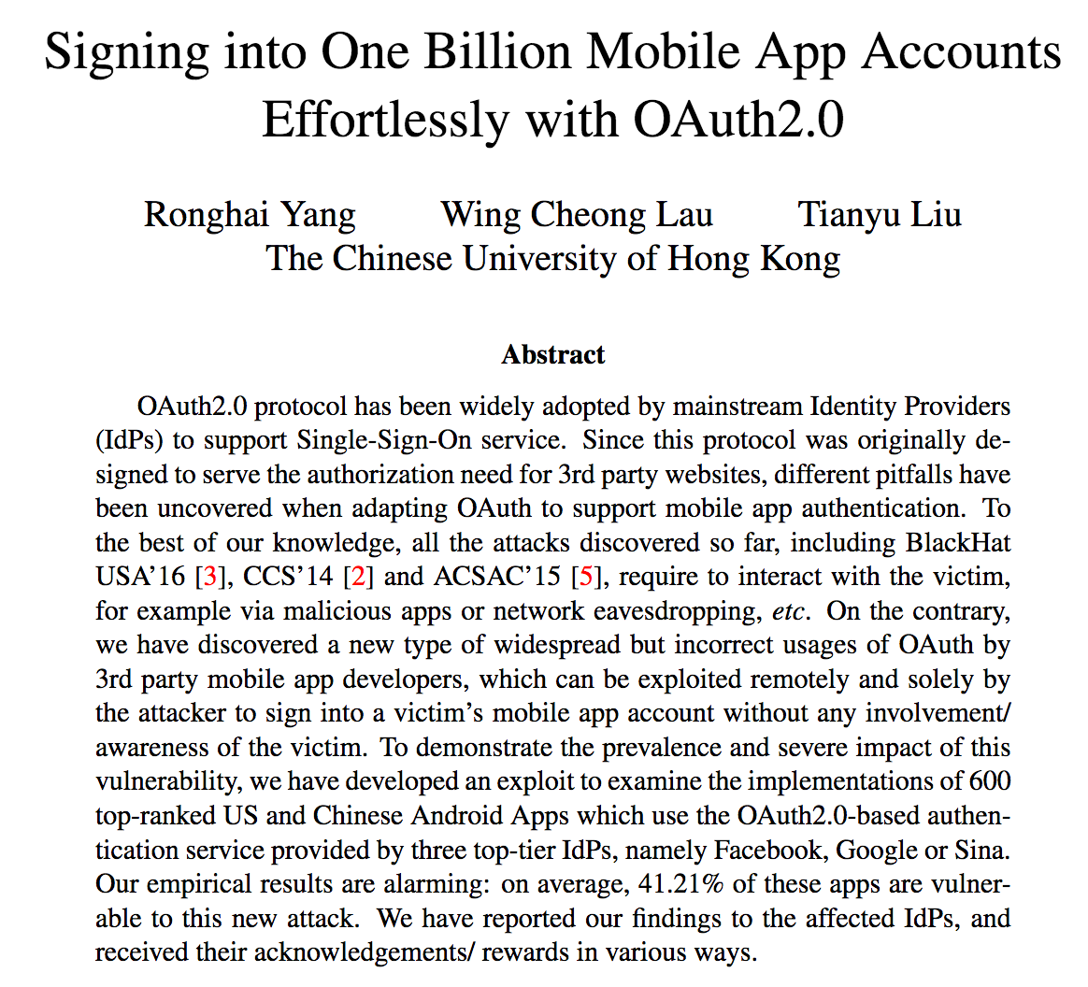

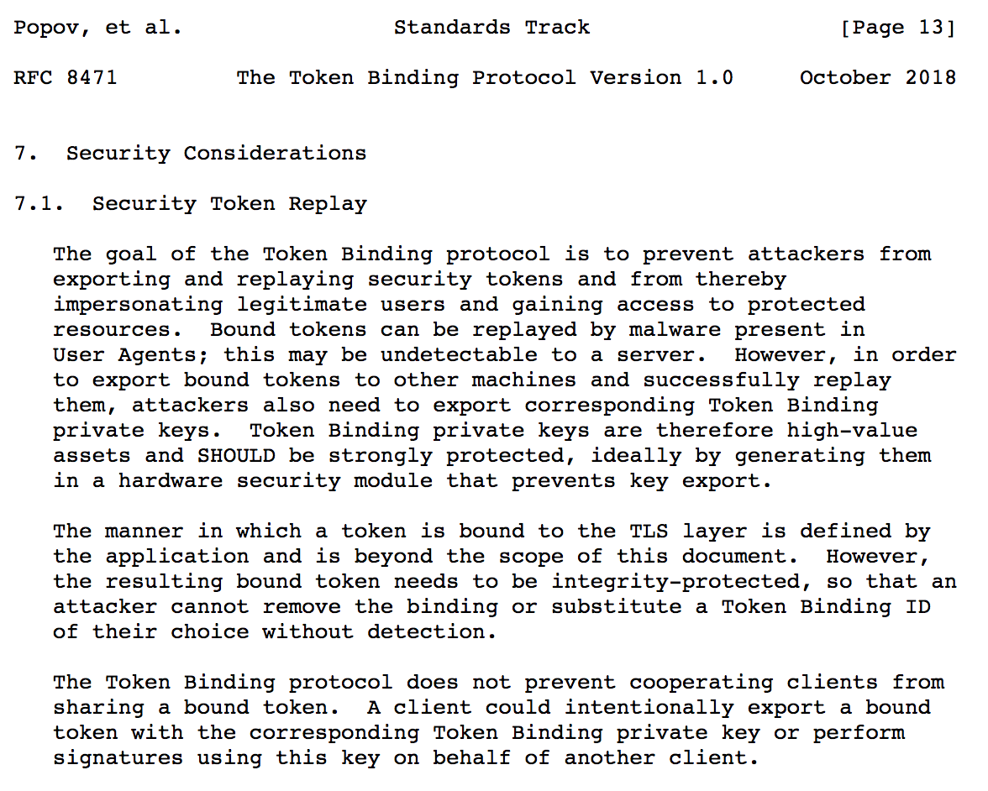

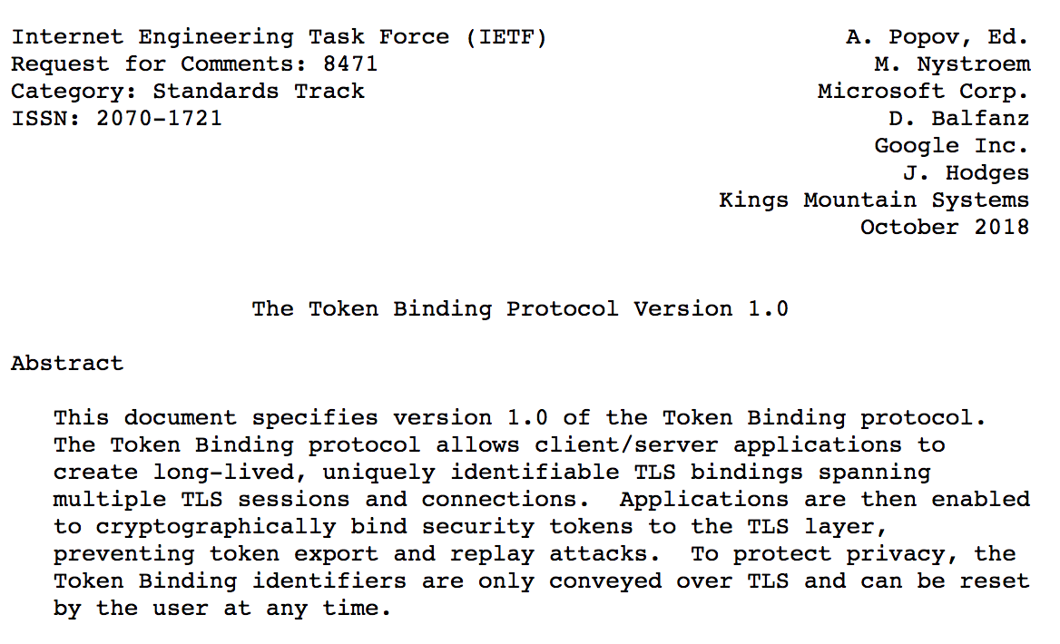
OAuth 2
Application Name
Application Website
Redirect URI or Callback URL
client credentials"
client identifier
client secret.
https://github.com/login/oauth/authorize?response_type=code&client_id=CLIENT_ID&redirect_uri=CALLBACK_URL&scope=read
https://dropletbook.com/callback?code=AUTHORIZATION_CODE
https://cloud.digitalocean.com/v1/oauth/token?client_id=CLIENT_ID&client_secret=CLIENT_SECRET&grant_type=authorization_code&code=AUTHORIZATION_CODE&redirect_uri=CALLBACK_URL
{"access_token":"ACCESS_TOKEN","token_type":"bearer","expires_in":2592000,"refresh_token":"REFRESH_TOKEN","scope":"read","uid":100101,"info":{"name":"Mark E. Mark","email":"mark@thefunkybunch.com"}}
curl -X POST -H "Authorization: Bearer ACCESS_TOKEN""https://api.digitalocean.com/v2/$OBJECT"

Slide 23


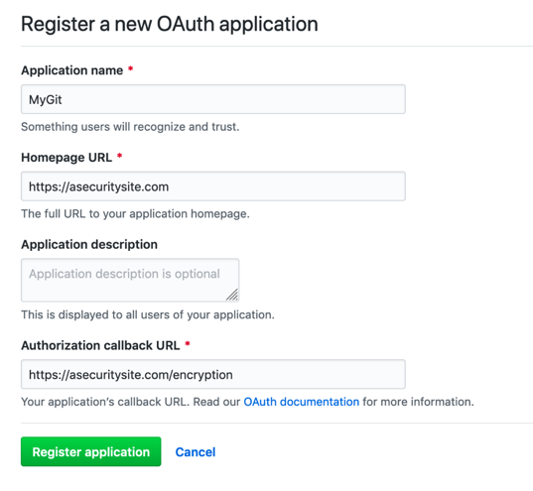
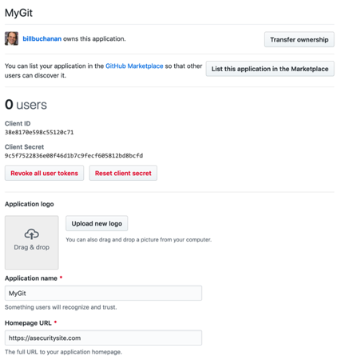

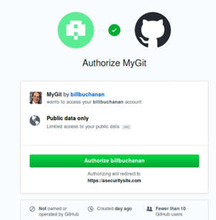
Federated ID

Slide 24
Tokens, Authorization and Docker Fernet Tokens Prof Bill Buchanan OBE http://asecuritysite.com/tokens

Slide 25
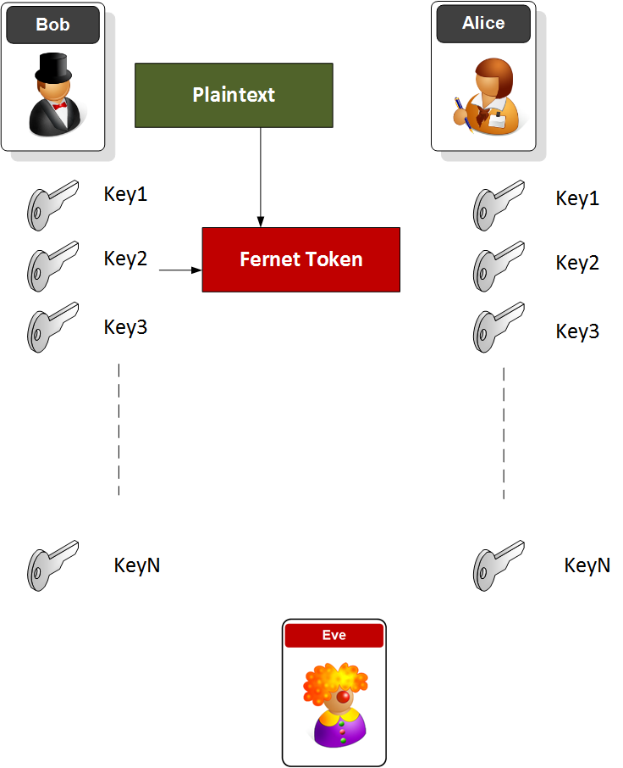
Fernet Token
The token has a version number, a time stamp, the IV, the cipher text and an HMAC signature:
Version: 8 bits
Timestamp: 64 bits (the number of seconds since between January 1, 1970 UTC and the time of the encryption.
IV: 128 bits
Ciphertext - variable length: Multiple of 128 bits
HMAC: 256 bits here.

Slide 26
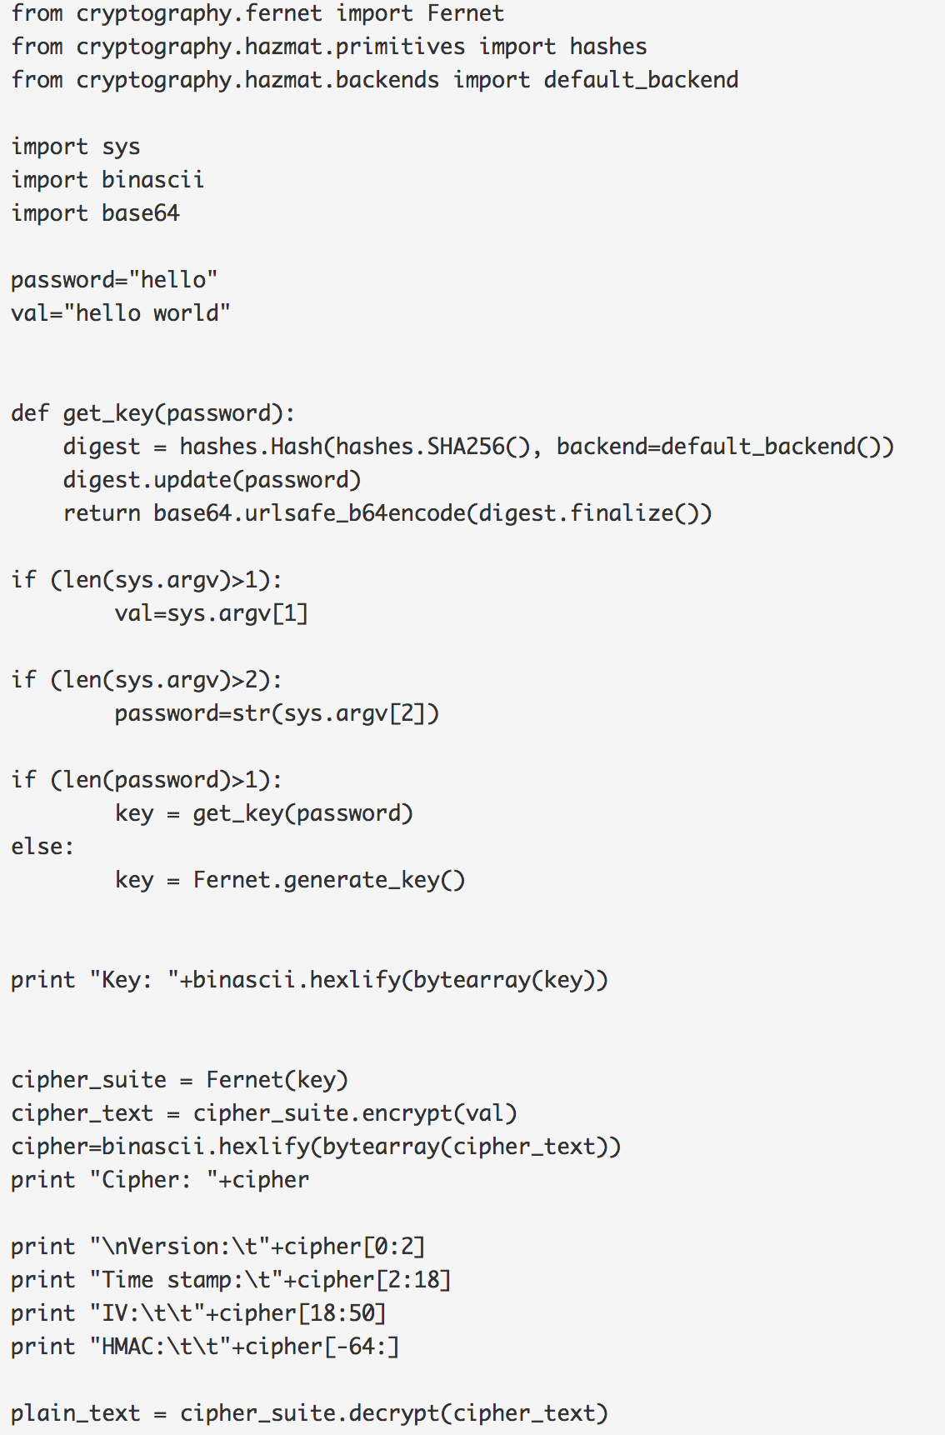
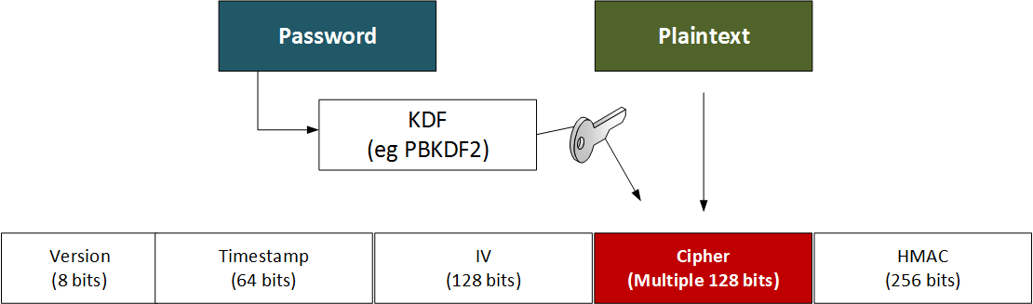
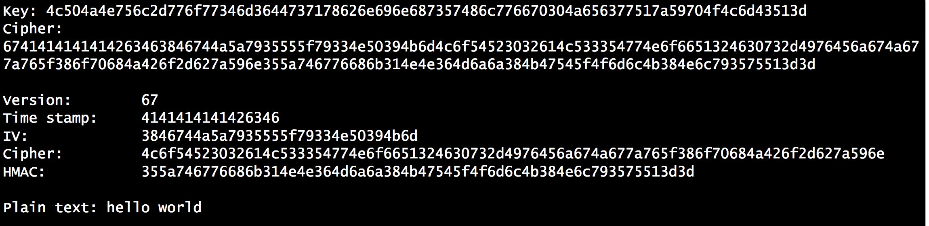
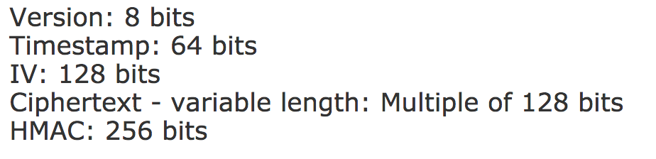
Fernet
AES 128-bit.
256-bit HMAC.
AES CBC.
PKCS7 padding [here].

Slide 27
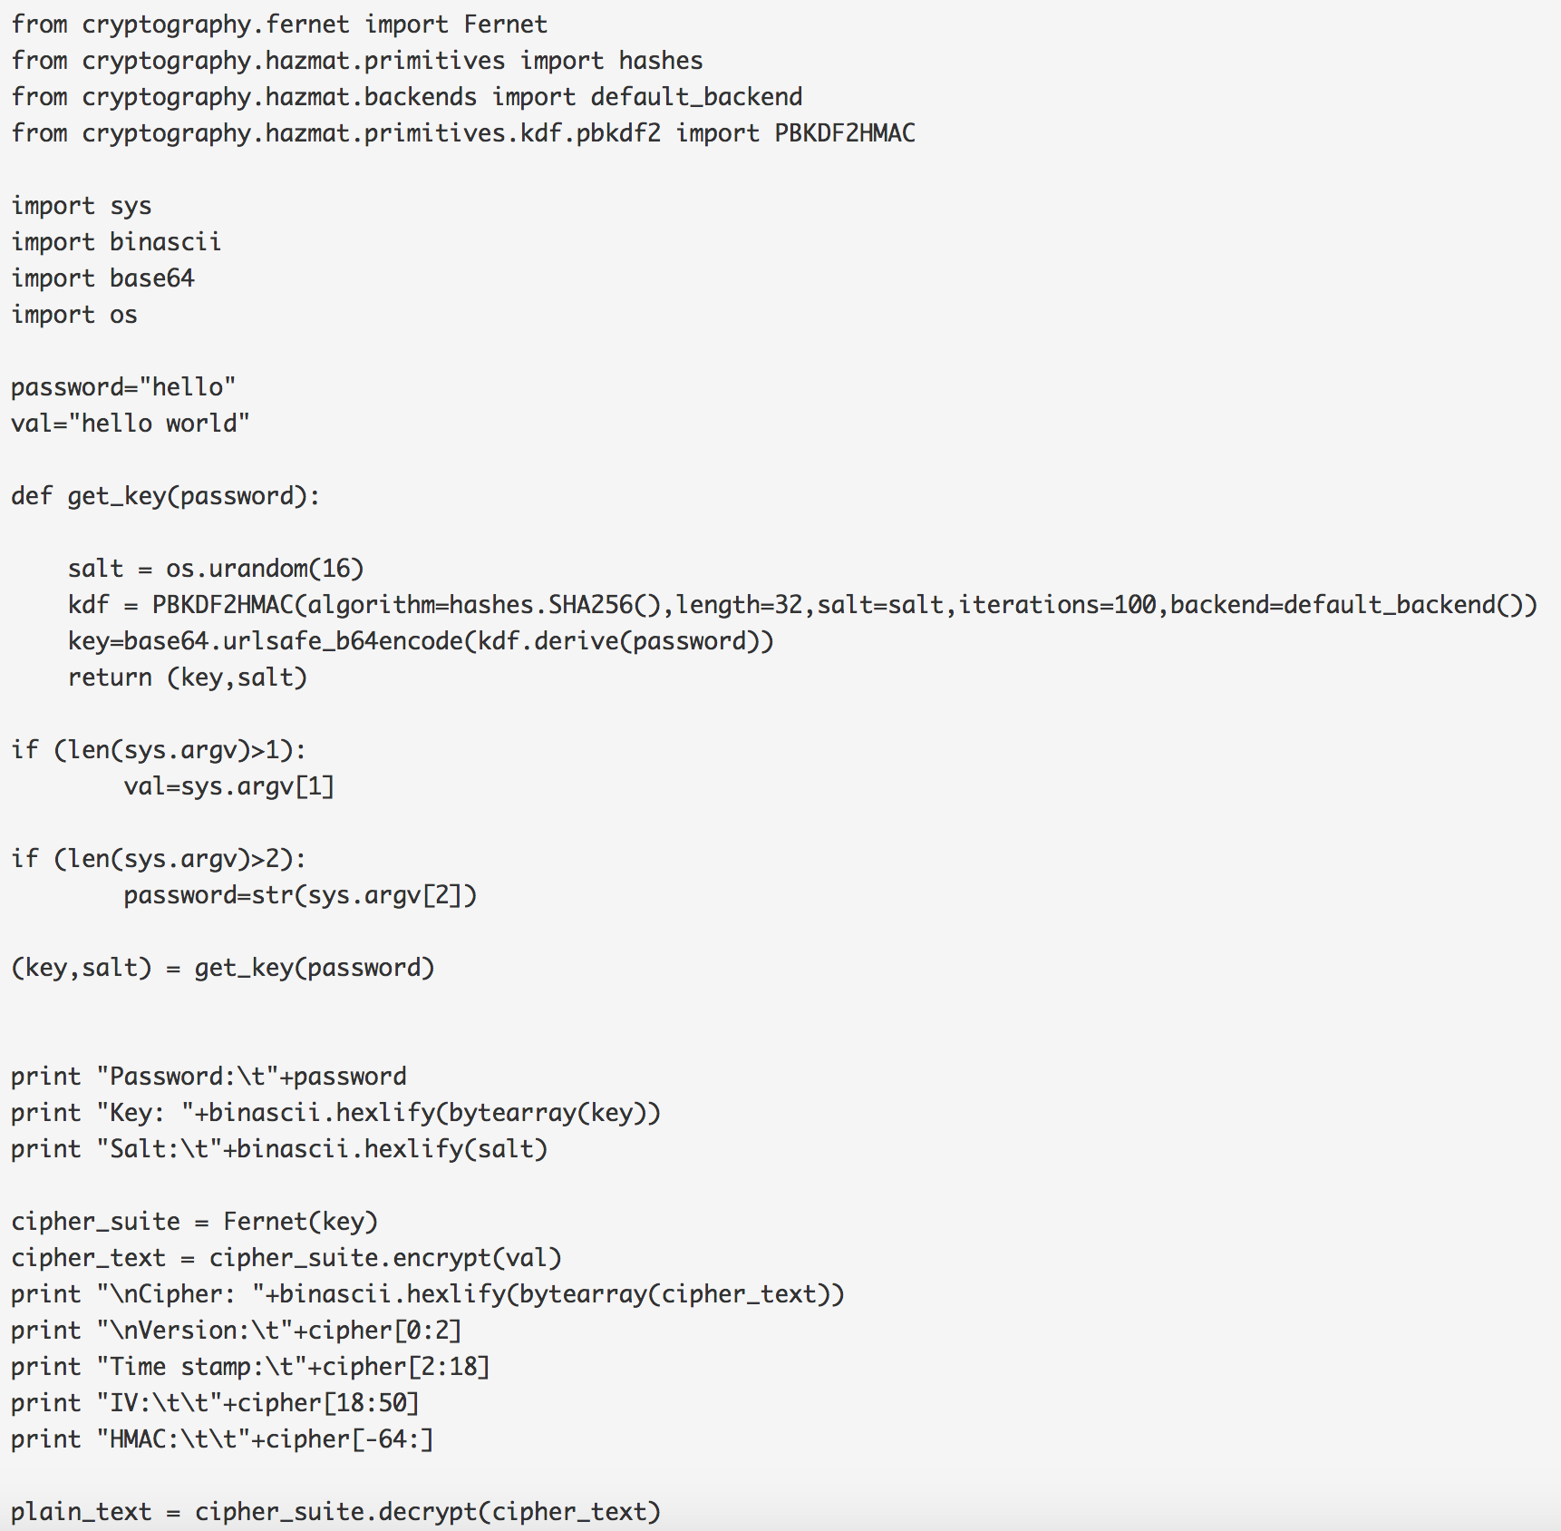
Fernet
AES 128-bit.
256-bit HMAC.
AES CBC.
PKCS7 padding [here].

Slide 28
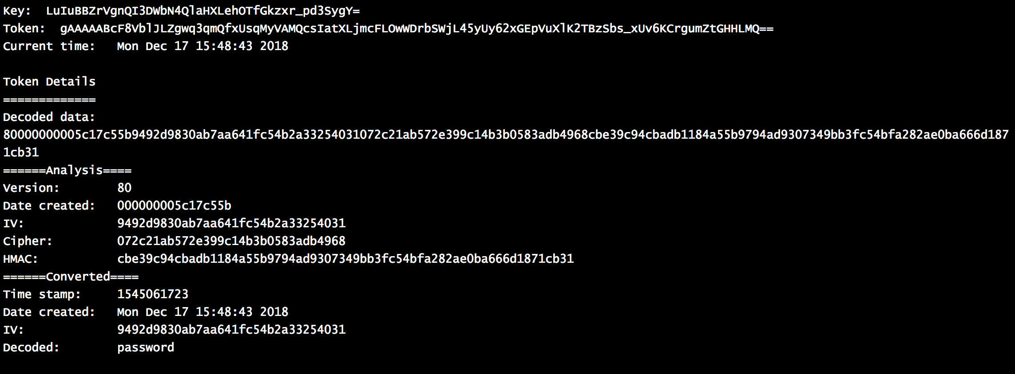
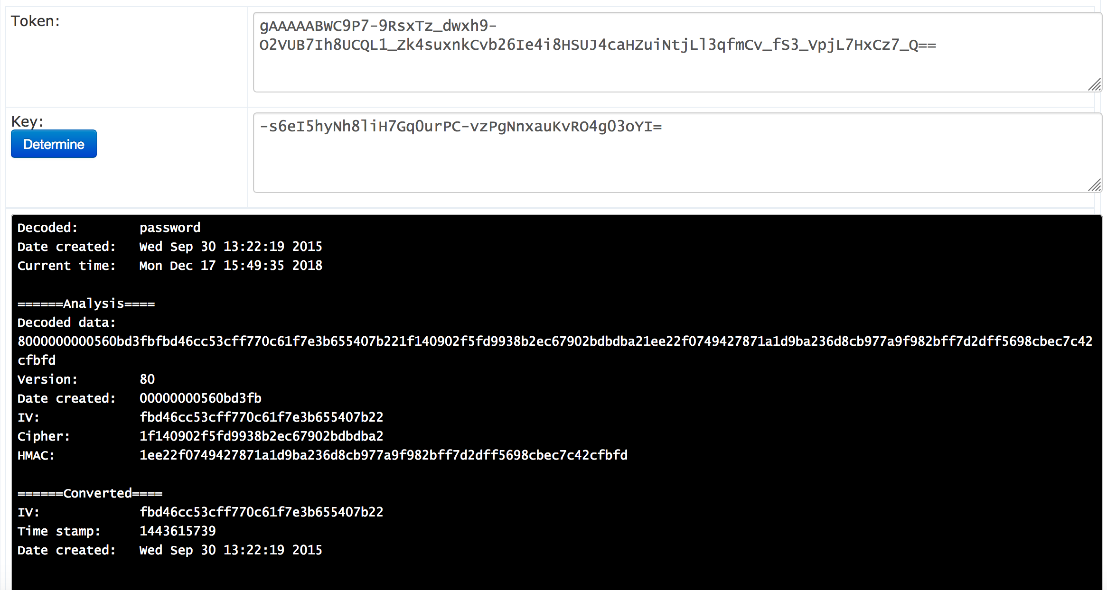
URL Safe

Slide 29

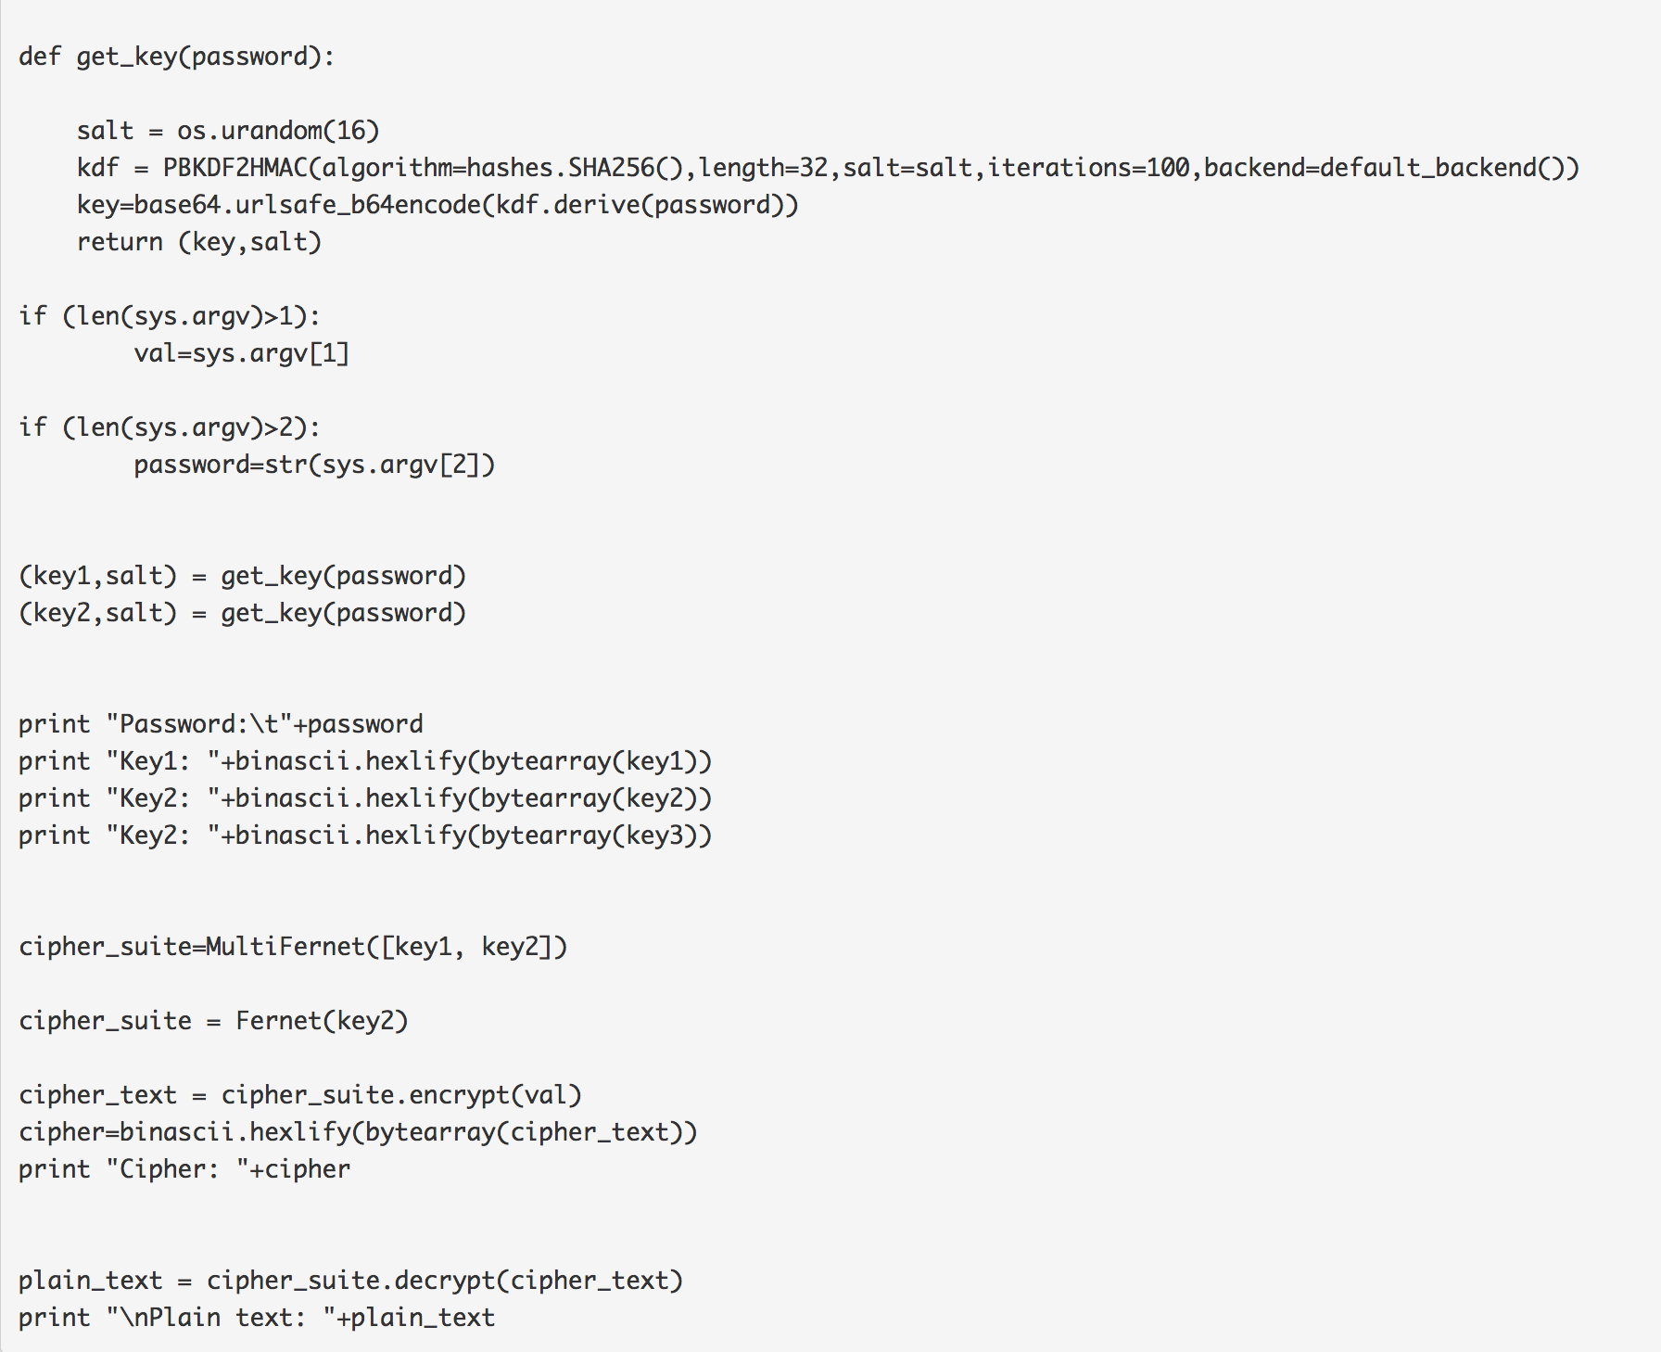
Key Rotation

Slide 30
Tokens, Authorization and Docker PAKE Prof Bill Buchanan OBE http://asecuritysite.com/tokens

Slide 31
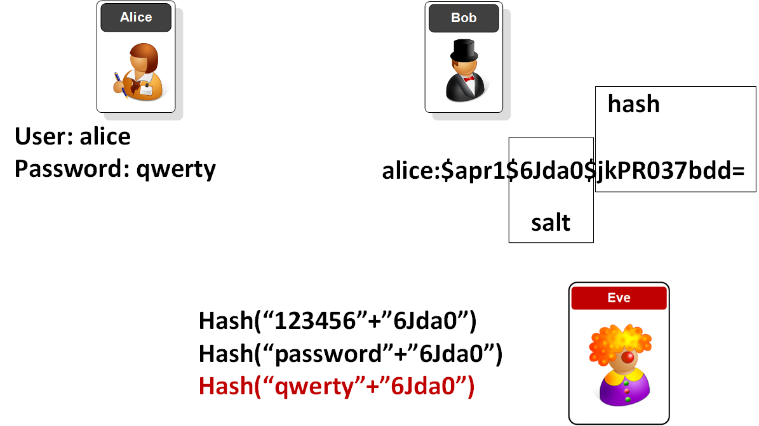
The problem with passwords, hashing and salt

Slide 32
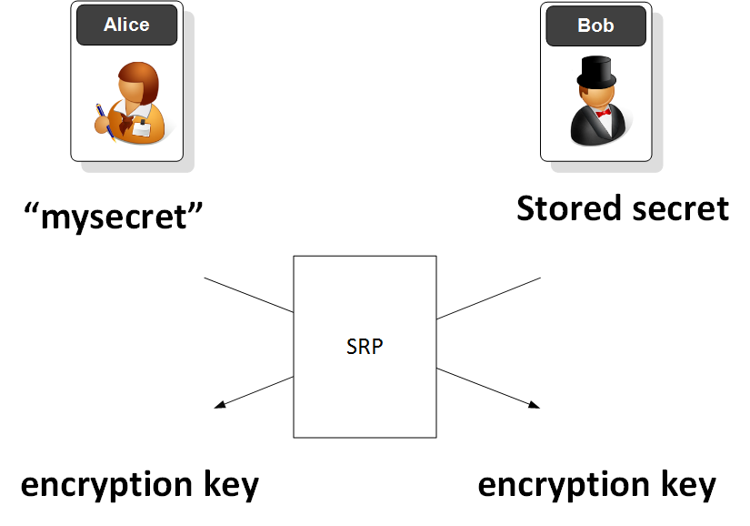
SRP

Slide 33
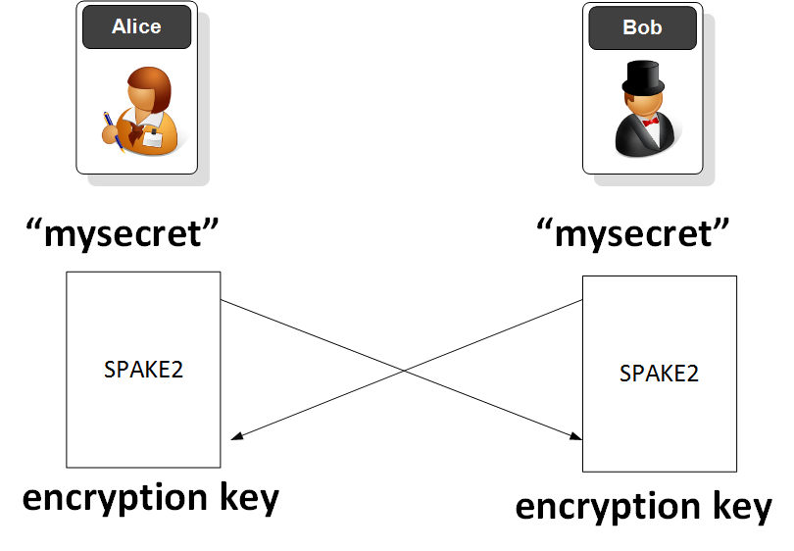
SPAKE2 (Password-Authenticated Key Exchange)

Slide 34
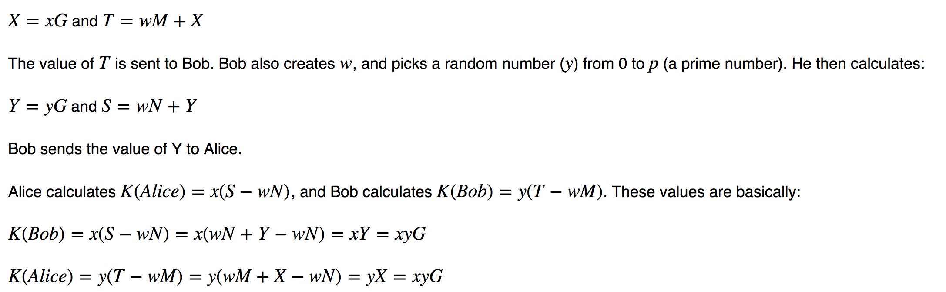
SPAKE2 (Password-Authenticated Key Exchange)

Slide 35
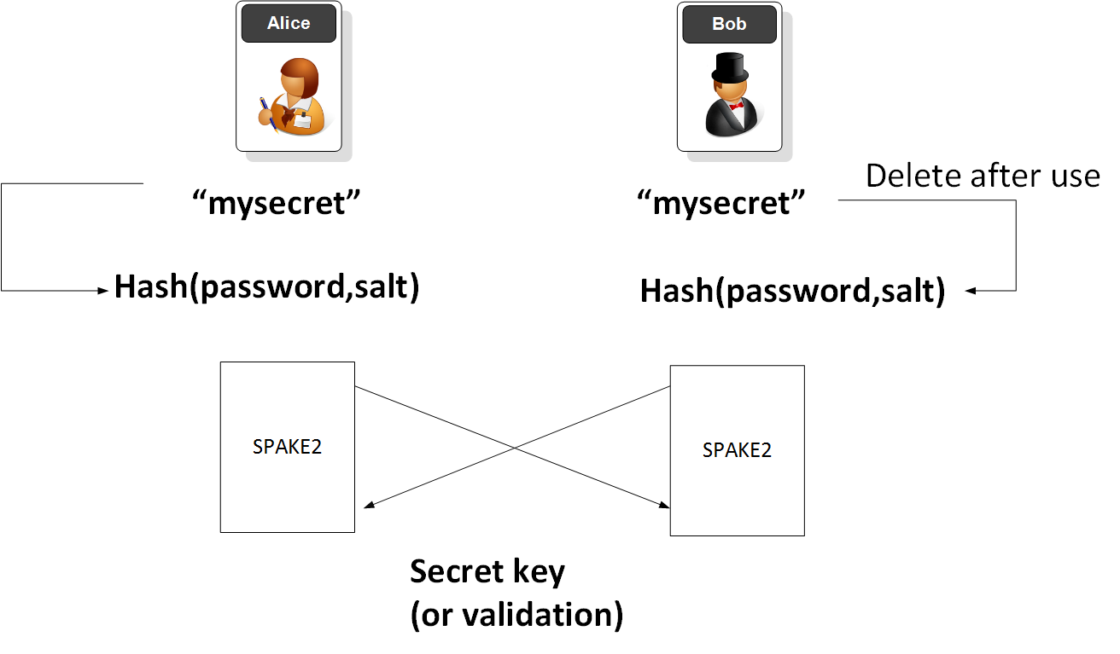
Proving Password

Slide 36
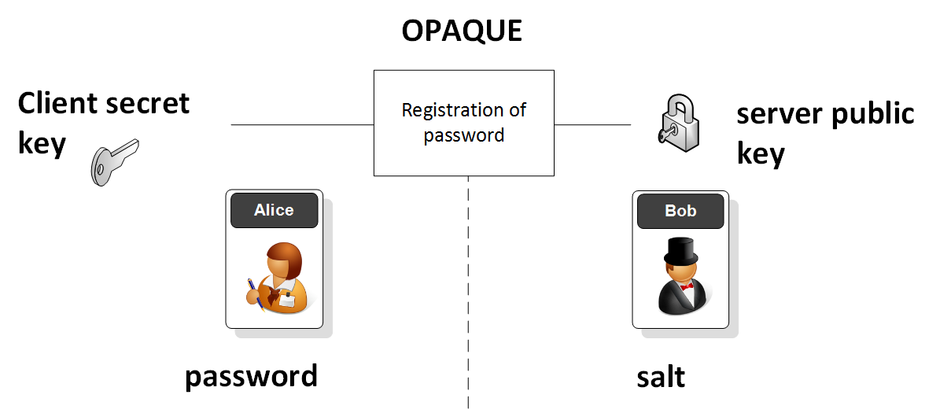
OPAQUE

Slide 37
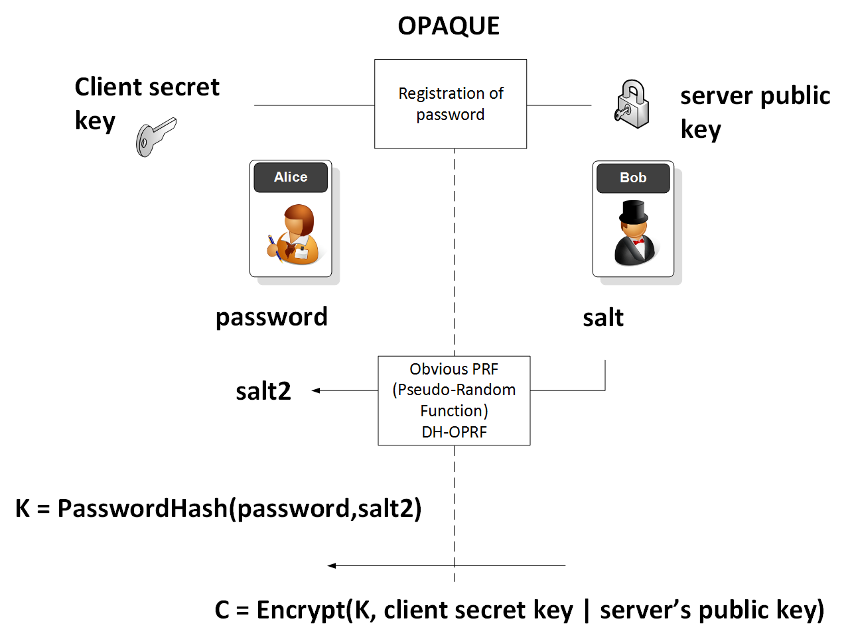
OPAQUE

Slide 38
Tokens, Authorization and Docker Docker Prof Bill Buchanan OBE http://asecuritysite.com/tokens

Slide 39
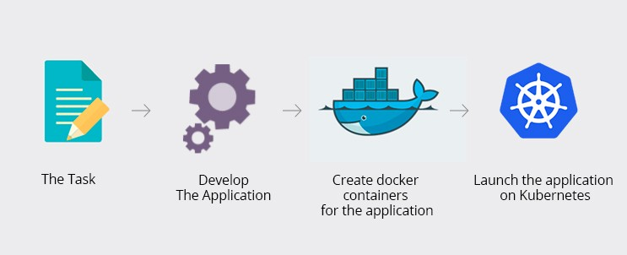

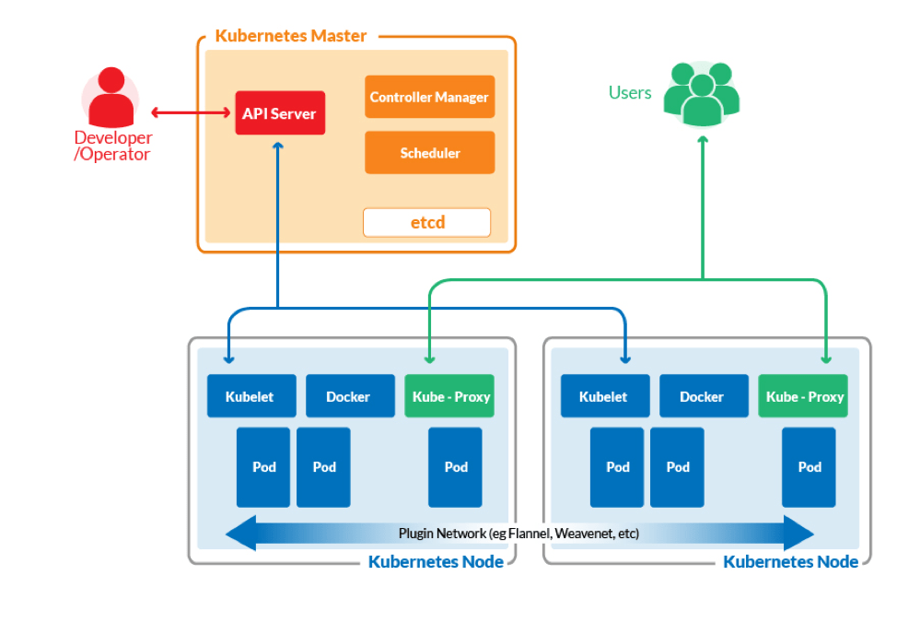

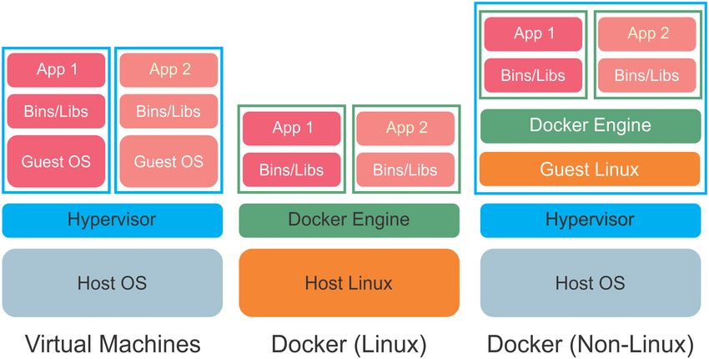
Docker
FROM ubuntu:16.04
RUN apt-get update && apt-get install -y openssh-server
RUN mkdir /var/run/sshd
RUN echo 'root:THEPASSWORDYOUCREATED' | chpasswd
RUN sed -i 's/PermitRootLogin prohibit-password/PermitRootLogin yes/' /etc/ssh/sshd_config
# SSH login fix. Otherwise user is kicked off after login
RUN sed 's@session\s*required\s*pam_loginuid.so@session optional pam_loginuid.so@g' -i /etc/pam.d/sshd
ENV NOTVISIBLE "in users profile"
RUN echo "export VISIBLE=now" >> /etc/profile
EXPOSE 22
CMD ["/usr/sbin/sshd", "-D"]
Hung, L. H., Kristiyanto, D., Lee, S. B., & Yeung, K. Y. (2016). GUIdock: using Docker containers with a common graphics user interface to address the reproducibility of research. PloS one, 11(4), e0152686.

Slide 40
Tokens, Authorization and Docker ECR-20 Tokens
JSON Web Tokens
OAuth 2.0
Fernet Tokens
PAKE
Docker
Prof Bill Buchanan OBE http://asecuritysite.com/tokens

